Slide 1
Phonics at Askwith Primary School
Phonics Bug: a systematic synthetic phonics programme that teaches letter sounds rapidly, showing children how to build up words with letters from the start, and always includes blending with printed words
Simultaneously teaches the segmentation of words for spelling and develops phonemic awareness skills
Two main session types - phoneme sessions & language sessions
Fast paced, multi-sensory, whole class teaching approach
Ongoing assessment identifies needs to quickly to ensure learning is maximised and children do not fall behind

Slide 2
Introduce Revisit/review Teach Practice Apply Assess learning | Learning intentions at the start of the session Previously learned sounds, blending reading and segmenting for spelling Sounds, reading, spelling, high frequency (common) words Practice opportunities including games and focus tasks Language sessions provide opportunities to apply reading, spelling and writing of captions and sentences including irregular/not fully decodable common words. Decodable reading books. Ongoing daily from interactions and at regular intervals following teaching periods. Allows any gaps to be quickly addressed so children do not fall behind
Teaching sequence and lesson structure

Slide 3
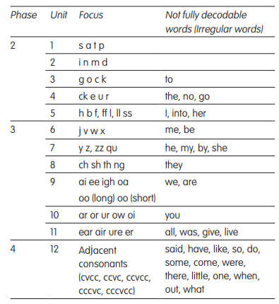
Phonic phases
Phonological awareness (Nursery)
Stories, rhymes, games, discussions to develop:
listening skills
knowledge of alliteration, rhyming and syllables
segmenting and blending skills
Phase 2 – 4 (Reception)
s, a, t, p…(see table)
to, the, no, go…(see table)
Language rich environment

Slide 4
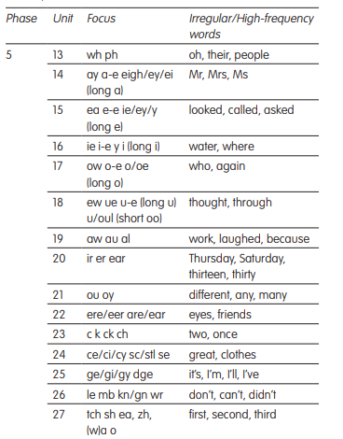
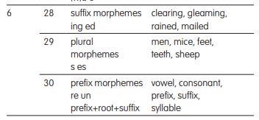
Phase 5 - 6 (KS1 – Years 1 and 2)
Phase 5
Recaps previous sounds
Phase 5 knowledge → new graphemes for reading
alternative pronunciations
alternative spellings of all graphemes.
Phase 6
more complex, multi-syllabic words and morphemes such as prefixes and suffixes.

Slide 5
Phonics in Year 3
Full phonics check in September (up to the end of Phase 6)
Any gaps or misconceptions are addressed
Teaching
RAPID (Bug Club intervention programme)
Spelling focus
Lowest 20% - daily readers

Slide 6
Phonics for SEND
LL to complete

Slide 7
Reading
ActiveLearn Login (activelearnprimary.co.uk)
Children apply sound knowledge to reading books (aligned directly to phonics)
Link to ActiveLearn (Bug Club) is on school website
Home access online to reading books
Username:
Full first name and the first letter of their surname in capitals. There is no space between these. Eg: Joseph Smith’s = JosephS
Password is: password
School code is: laj6

Slide 8
Reading on Bug Club

Slide 9
1. These sounds will be sounds that the children are learning that week in phonics. Alternatively, they could be sounds the children need more practice applying in whole words. It is important the children deliberately practise these sounds before they read.
Help and support with discussions which could take place when reading.
These could be before, during or after reading.
2. Practise blending the sounds within whole words.
When using Bug Club, there is a ‘bug’ on this cover page which will read the phonic sounds, from Blue reading books onwards.
3. Practise reading the tricky words. These are sight words which will not necessarily follow typical ‘rules’

Slide 10
current sounds current irregular/tricky words previous sounds (recent) previous irregular/tricky words

Slide 11
How to help at home
Read the books that have been sent home with your child (access online books too):
recommended daily
use the inside covers for guidance and phonics practice
Be careful to avoid a ‘schwa’ when discussing and modelling the sounds e.g. for /m/ - “mm” not “m-uh”, for /j/ - “j” not “j-uh”, for /l/ - “ll” not “l-uh”
Spelling practice
support your child when practising their spellings
rhymes, spelling patterns, dictation

Slide 12
Any questions?

