Slide 1
Variation and Variety in Maths

Slide 2
Variation
Careful choice of what to vary
Careful choice of what the variation will draw attention to
Based on misconceptions and prior knowledge of the child/children you are working with

Slide 3
2 digit number plus a 1 digit number
Set 1
42 + 3 57 + 8 87 + 1 35 + 1
Set 2
49 + 4 27 + 8 12 + 9 66 + 5
*All are 2 digit plus 1 digit
*The second set all intentionally cross a tens barrier

Slide 4
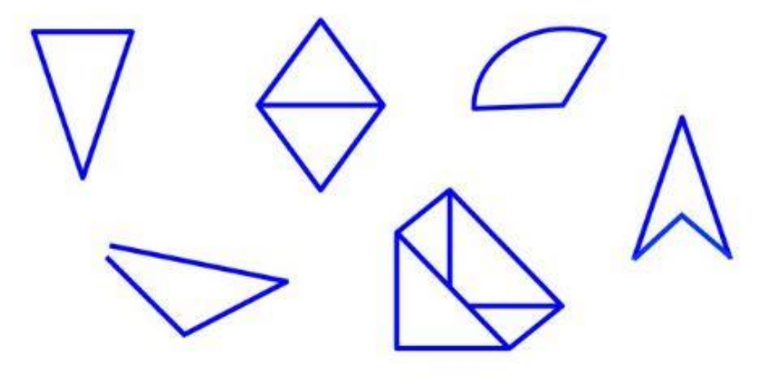
Triangle or not a triangle
*All have aspects of a triangle
*Not all full polygons

Slide 5
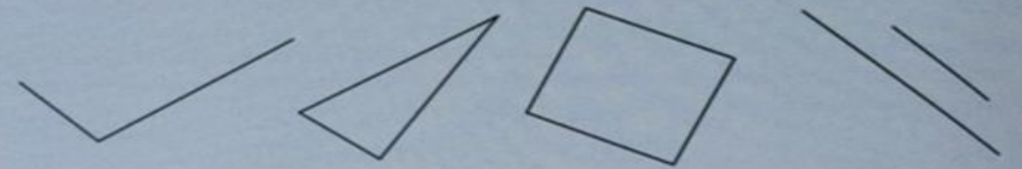
Standard or non standard?
Over half of 8 year olds did not recognize the top images as examples of: right angles, triangles, a square or parallel lines.
Children’s understanding can be limited by not exposing them to enough variation in lessons, this is true mastery and deepening.

Slide 6
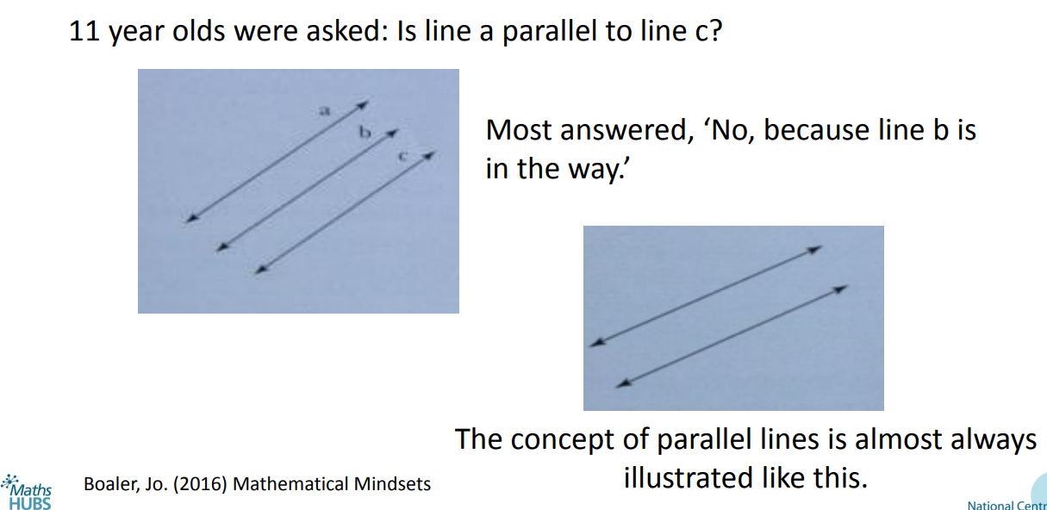
Parallel or not parallel?
Look at the two images:
What is the same? What is different?

